Slide 1
DB2 TO SQL
Presented By:
187200 SARIKA S
186978 SHALINI PATHAK
187089 GEETHA GUMMADI
180603 DIVYANSHU CHITRANSHI
186956 YNV DIVYA SUPRIYA LINGAMALLU
186969 SRINIVASA LAXMI NARAYANA MURTHY TULASI

Slide 2
REQUIREMENTS
Map the structure of the source database to the corresponding destination database structure.
Unload the data from the source database.
Load the data into the target database using any tool or programming/scripting language for the mapping and unloading-loading part.

Slide 3
ABSTRACT
Migration of data from DB2 to oracle is done in this project.
The medium for the migration is IBM DB2 Cloud and UTL Packages in Oracle.

Slide 4
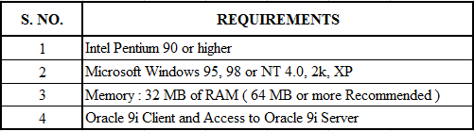
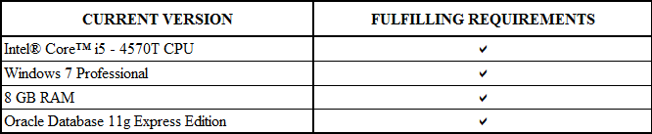
SOFTWARE REQUIREMENTS:
5 | DB2 environment
6500 CPU
10 pro
IBM DB2 Cloud

Slide 5
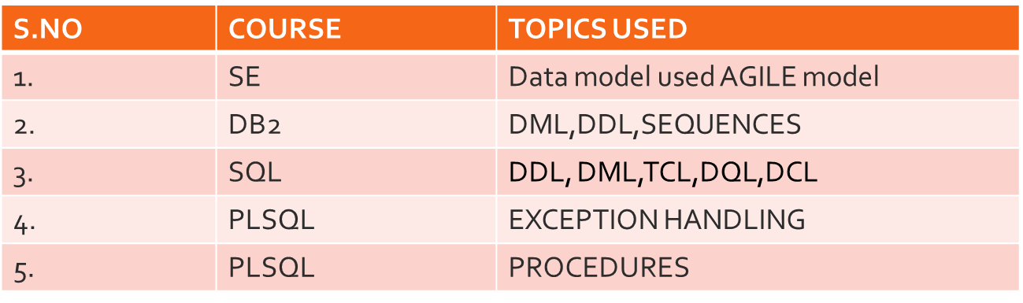

Slide 6
DESIGN PHASE
HIGH LEVEL DESIGN:
PROGRAMMING ETL
DB2
Fetch data from the DB2 table
Store the data in csv file
Convert CSV file into SQL table
Insert data into SQL
SQL queries

Slide 7
LOW LEVEL DESIGN
FLOW CHART
IBM DB2 Cloud
Creating table in the DB2 environment
Exporting the data from DB2 environment to CSV format file
Start
Oracle Environment
Loading each line in oracle table
Reading data line by line from CSV file
Creating directory in local disc using UTL package
End

Slide 8
DESIGN
Algorithm:
Step1: Creating a table in DB2 environment.
Step2: Inserting the data into DB2 table.
Step3: Export the data from DB2 environment to CSV format file.
Step4: Open the Oracle database and login as super user.
Step5: Create a directory in local disk.
Step6: Giving permissions to the normal user to access the directory and UTL file package.

Slide 9
Contd.
Step7: Login as normal user.
Step8: Create the table with the same structure as DB2 table.
Step9: Create procedure to access the UTL_file package.
Step10: Reading the data line by line from CSV file using UTL package.
Step11: Loading data into Oracle database.
Step12: Test the conversion by retrieving the data from table.

Slide 10
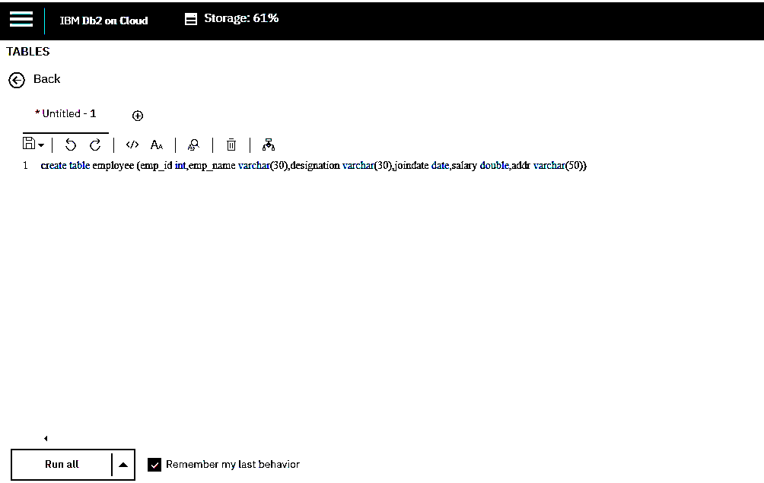
DEVELOPMENT PHASE

Slide 11
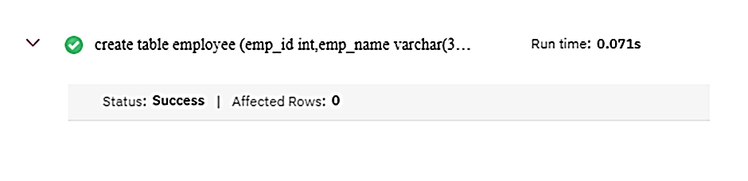
CREATION OF TABLE IN DB2
CREATE TABLE employee(emp_id INT NOT NULL,emp_name VARCHAR(30),
designation VARCHAR (30),joindate DATE,salary DOUBLE,addr VARCHAR
(50),CONSTRAINT p_e_id PRIMARY KEY (Emp_id))

Slide 12
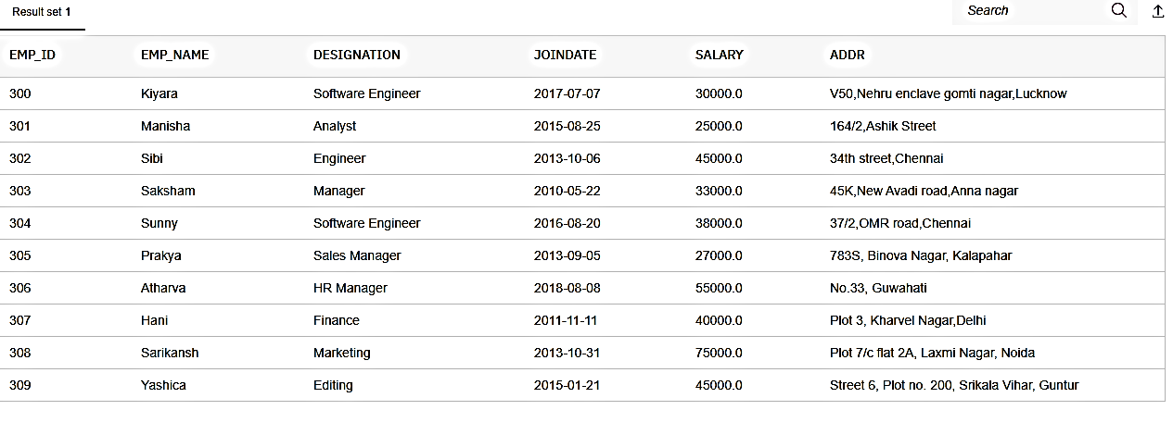
PROJECTION
INSERTION
INSERT INTO employee VALUES
(s1.nextval,'Kiyara','Software Engineer',
'07-07-2017',30000,'V50,Nehru enclave
gomti nagar,Lucknow')
PROJECTION
Select * from employee

Slide 13
CODING
create or replace procedure import_file is
ecount number := 1;
e_line varchar2(2000);
f utl_file.file_type;
e_dir varchar2(250);
fname varchar2(50);
Comma1 varchar(10);
Comma2 varchar(10);
Comma3 varchar(10);
Comma4 varchar(10);
Comma5 varchar(10);
e_empid number;
e_ename varchar2(30);
e_design varchar2(30);
e_date varchar2(10);
e_sal number;
e_add varchar2(50);

Slide 14
begin
e_dir := 'C:\PLP';
fname := 'export.csv';
f := utl_file.fopen('IMPORT_DIR',fname,'r');
loop
begin
if (ecount = 1) then
utl_file.get_line(f,e_line);
utl_file.get_line(f,e_line);
ecount := 0;
else
utl_file.get_line(f,e_line);
end if;
dbms_output.put_line(e_line);

